Slide 1
Product Reviews Analysis AI
Joseph Mendez and Emmanuel Audu

Slide 2
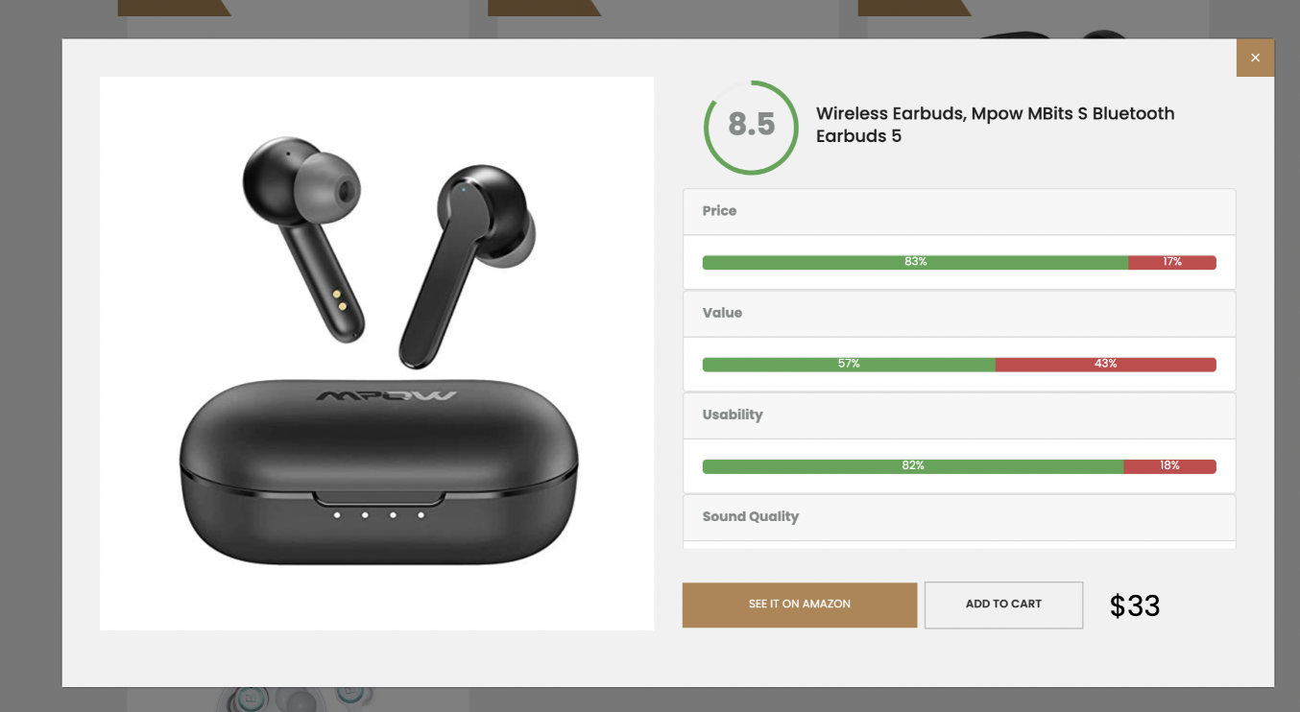
Product Description
Extract product information from E-commerce website
Scrape comments from website
Filter out fake comments using classification algorithm
Classify comments for products on e-commerce platforms
Score products based on the comments
Allow customers to see products scope on different classes

Slide 3
Implementation
JavaScript/Express JS for Front end
EJS Template for frontend
Python/Javascript class for sentiment analysis
Mongodb Database
Python/JavaScript classifier
Heroku hosting

Slide 4
Value Proposition
Solve choice dilemma for online shoppers
Make online shopping easier
Allow customers to trust in online reviews/product comments
Give shoppers the best product for their needs

Slide 5
Key Partners & Resources
Key Partners:
Internal
Developers
External
E-commerce businesses
Key Resources:
Website/Application
Online advertisements
Model pipeline and hosting

Slide 6
Revenue Generation
Advertising on our website and application
Affiliate marketing programs
Subscription fees (for premium service)

Slide 7
MVP Plan Implementation
February: Frontend & API Dev
March: Machine Learning (Classification model and topic modeler) Dev
April: Deployment

Slide 8
Currently done: 2/6 Thank you!

